Slide 1
Lecture 1: Introduction
Introduction
Complexity of problems
Sorting problem
Solving recurrences

Slide 2
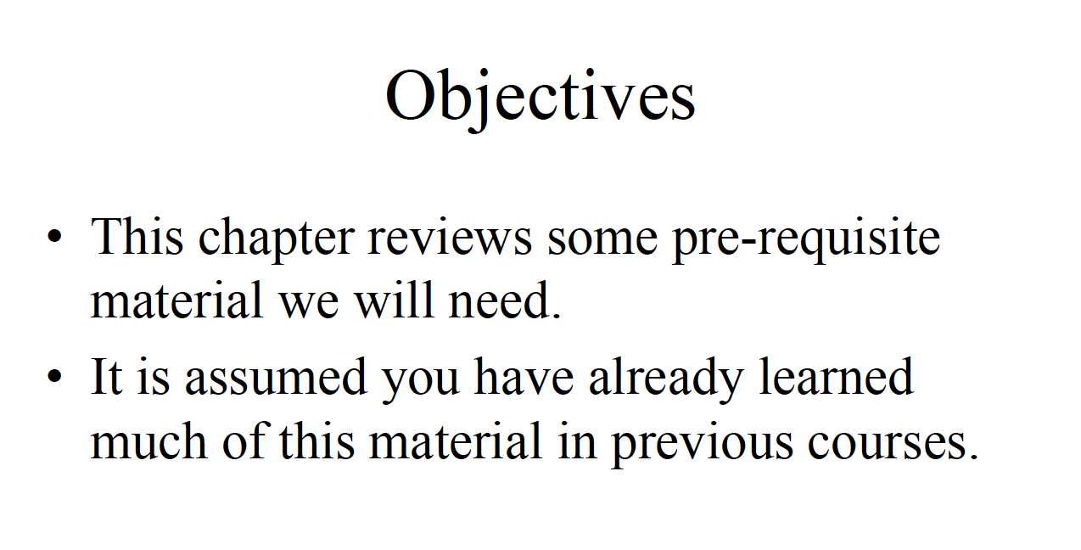

Slide 3
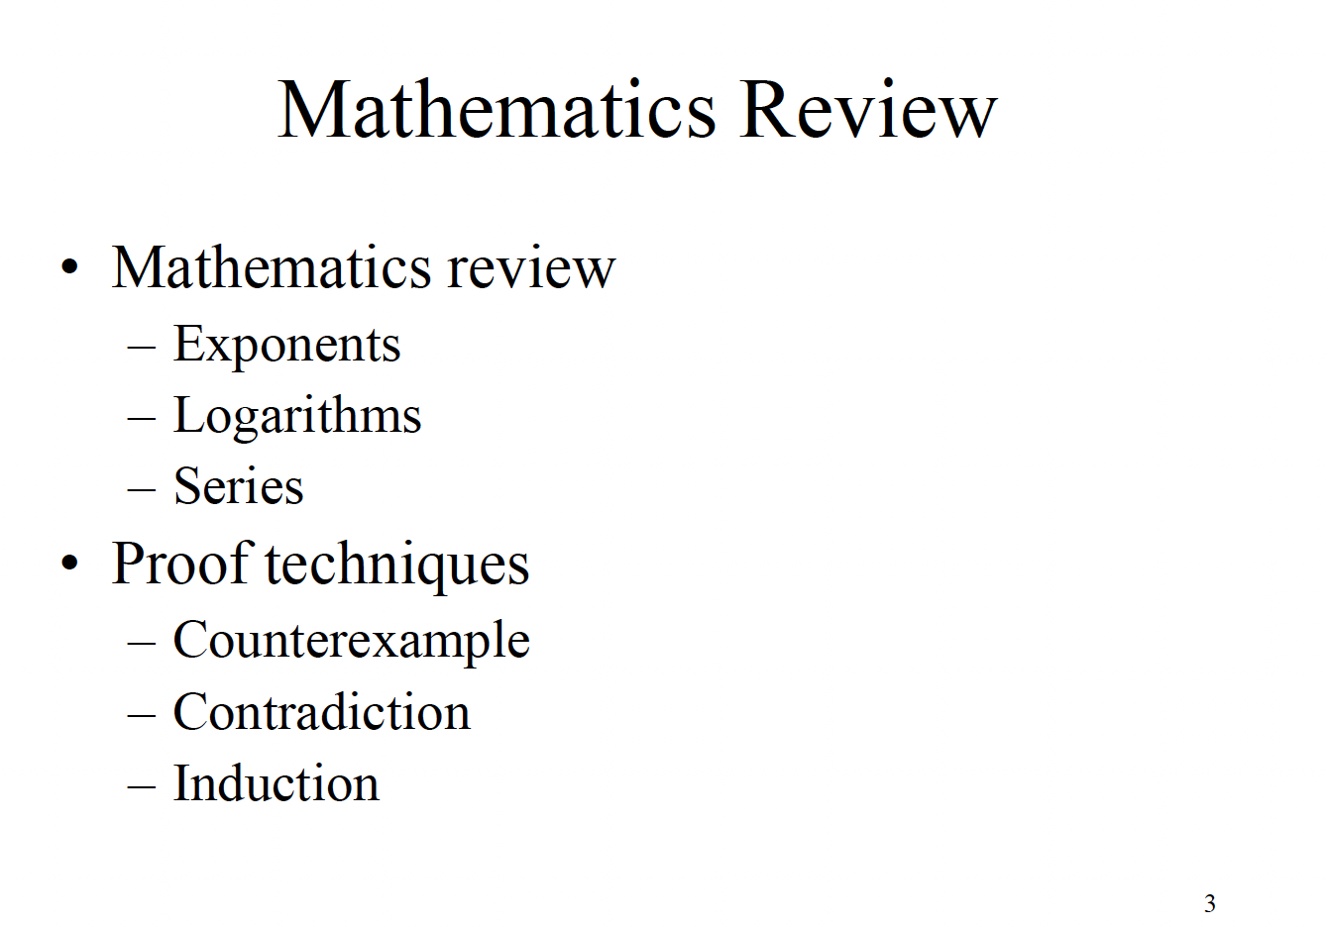

Slide 4
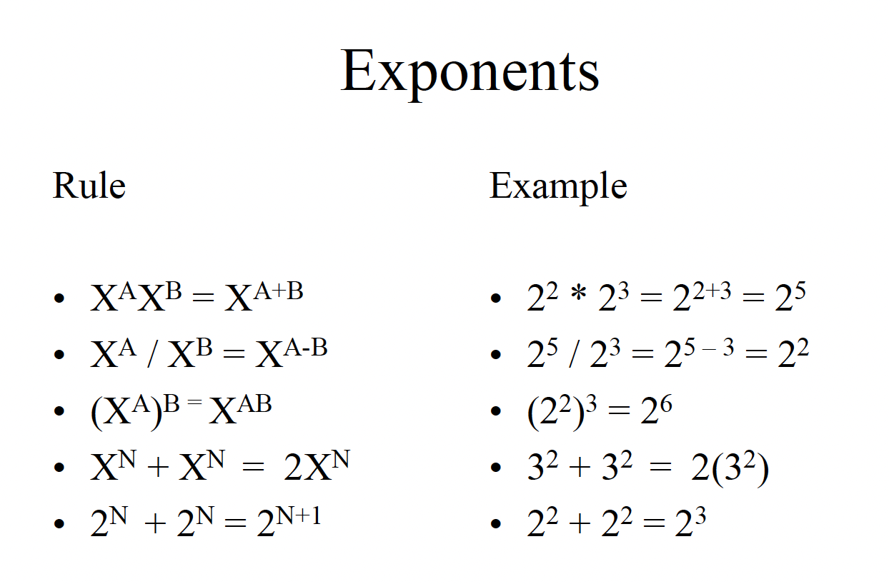

Slide 5
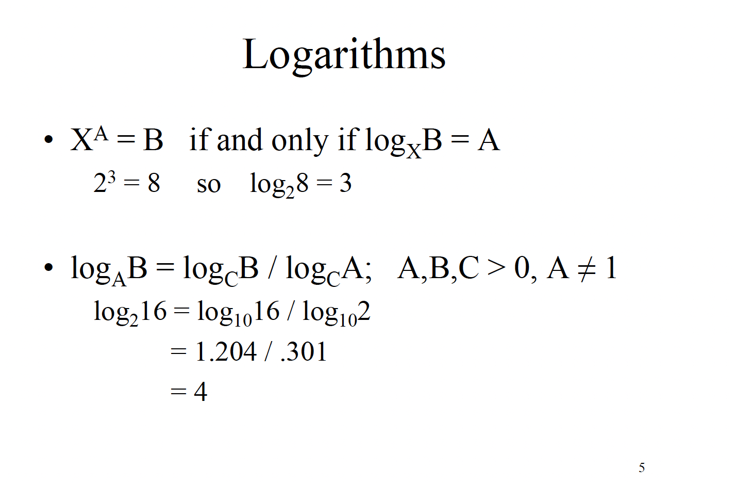

Slide 6
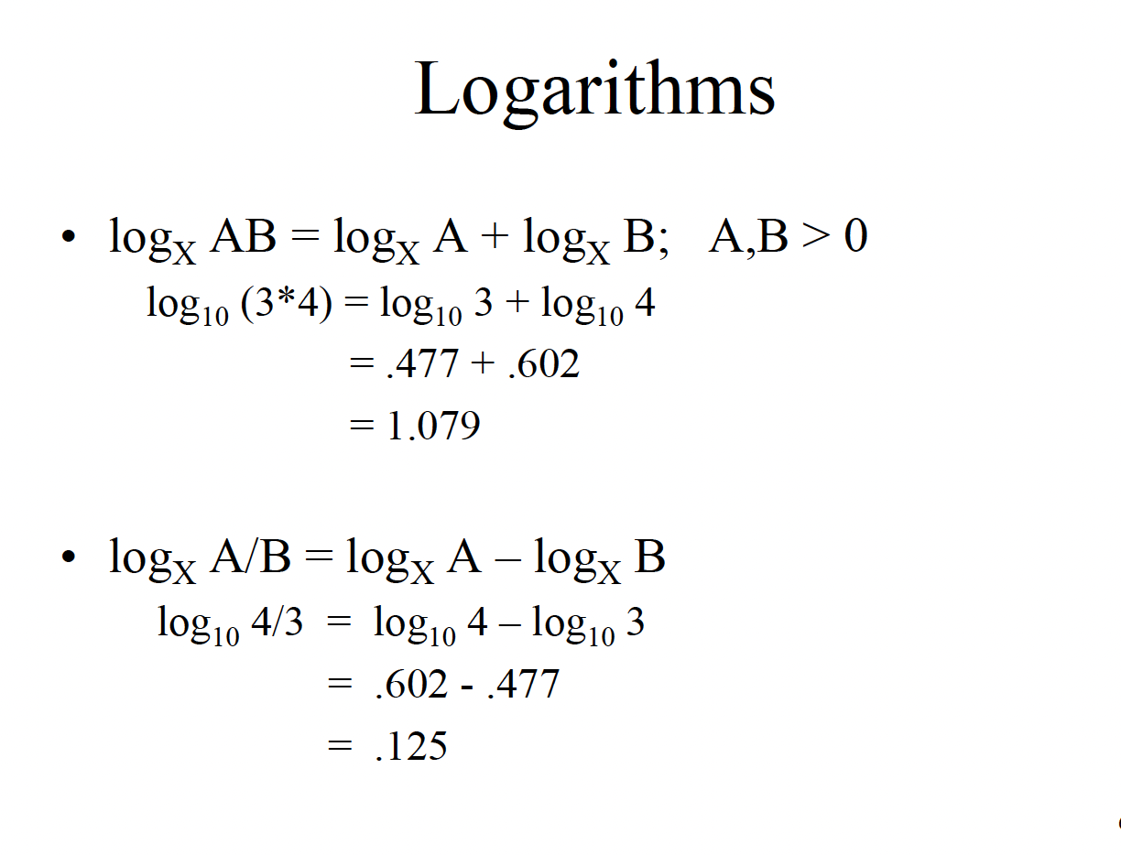

Slide 7
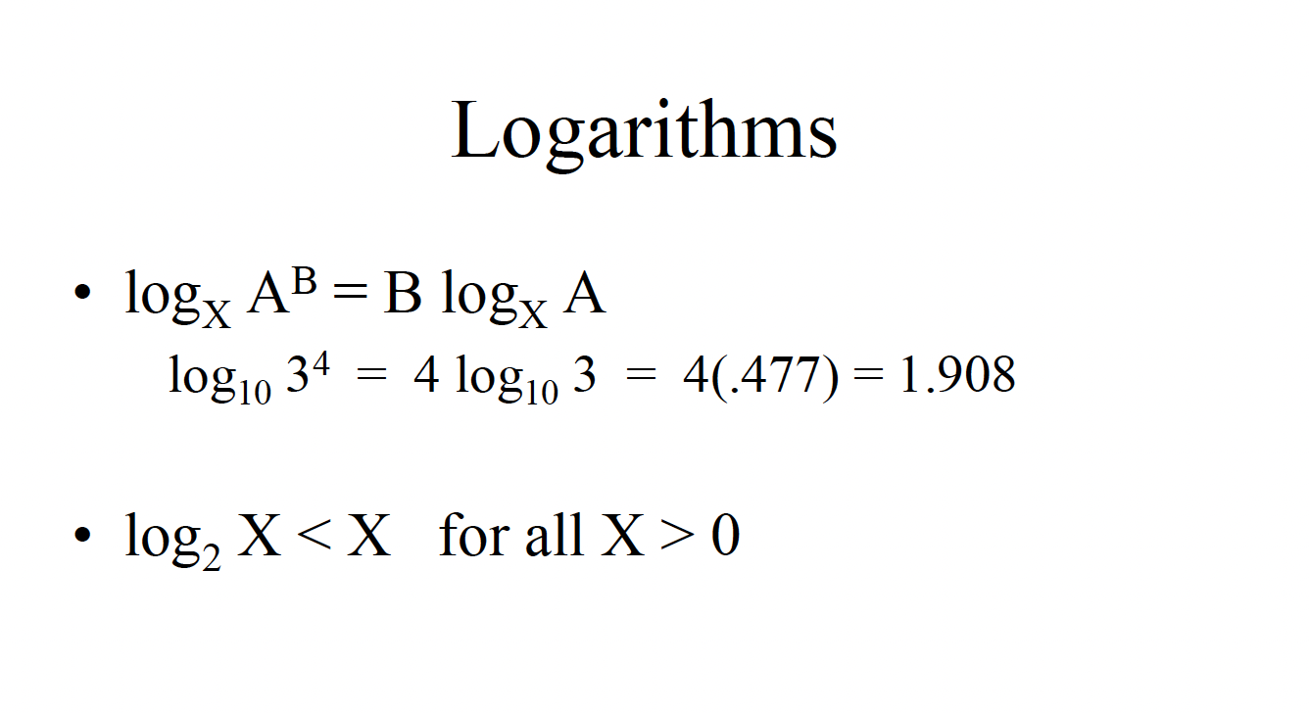

Slide 8
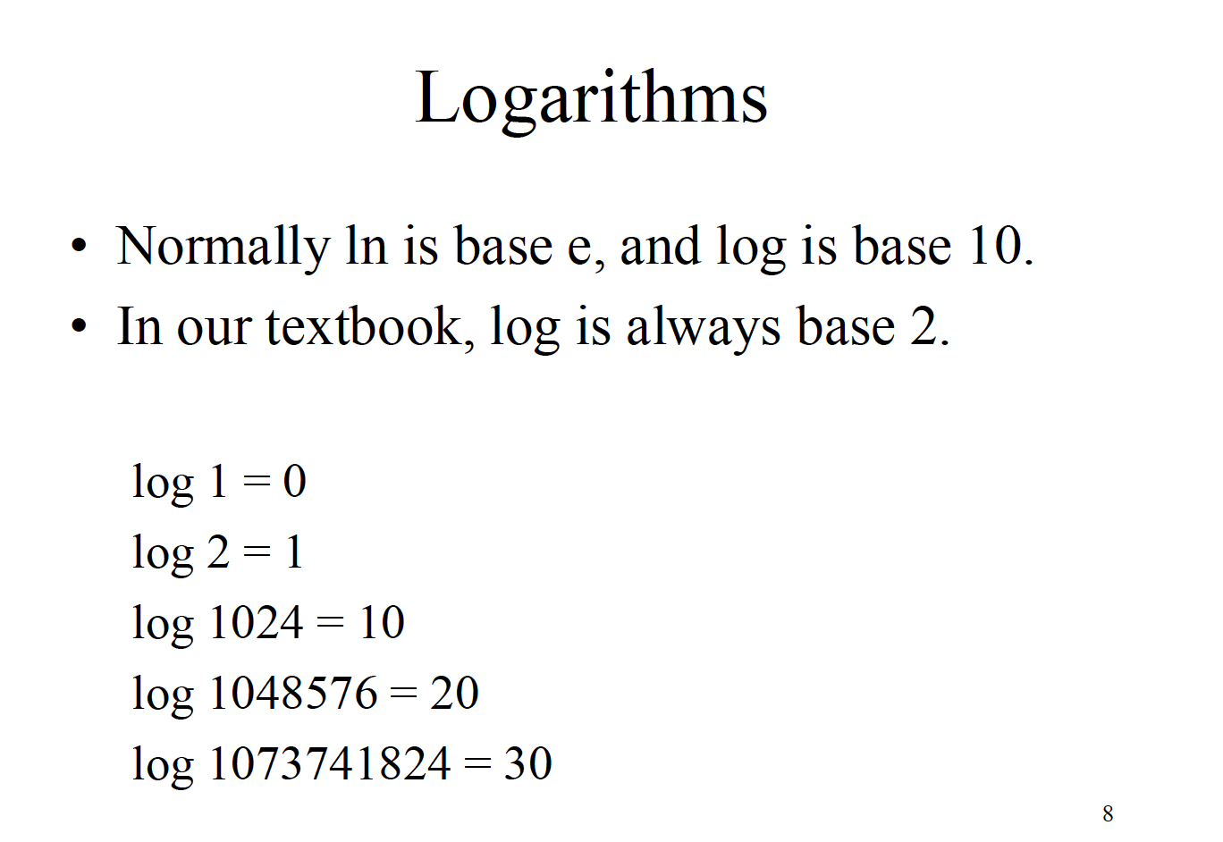

Slide 9
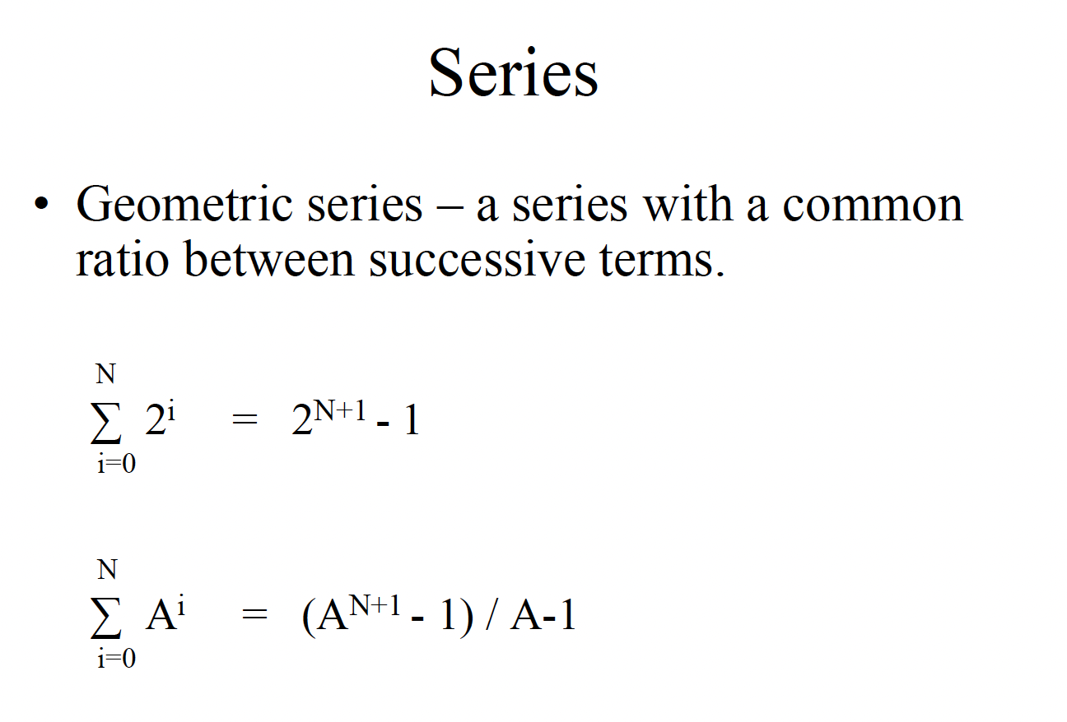

Slide 10
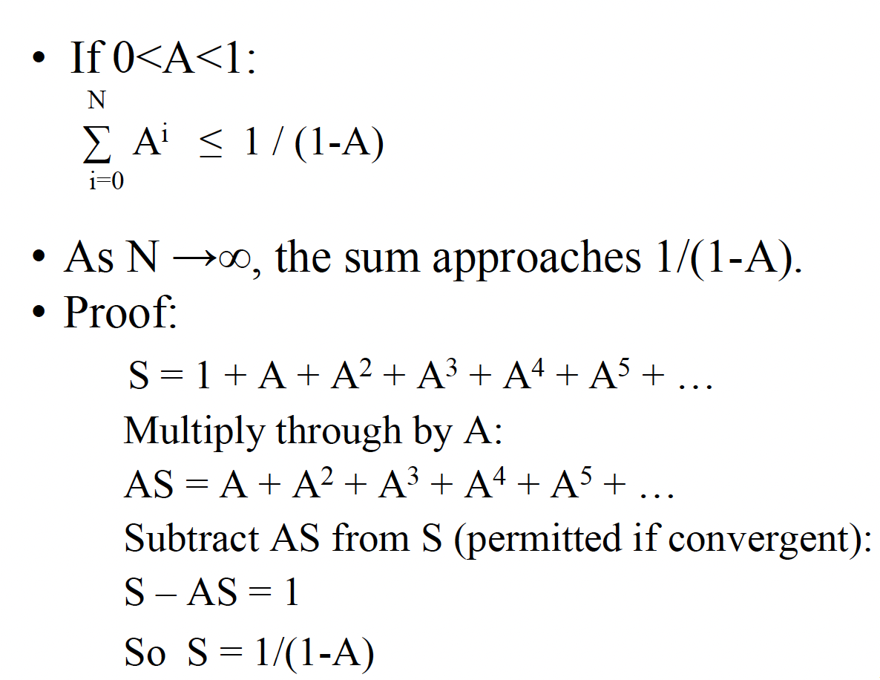

Slide 11
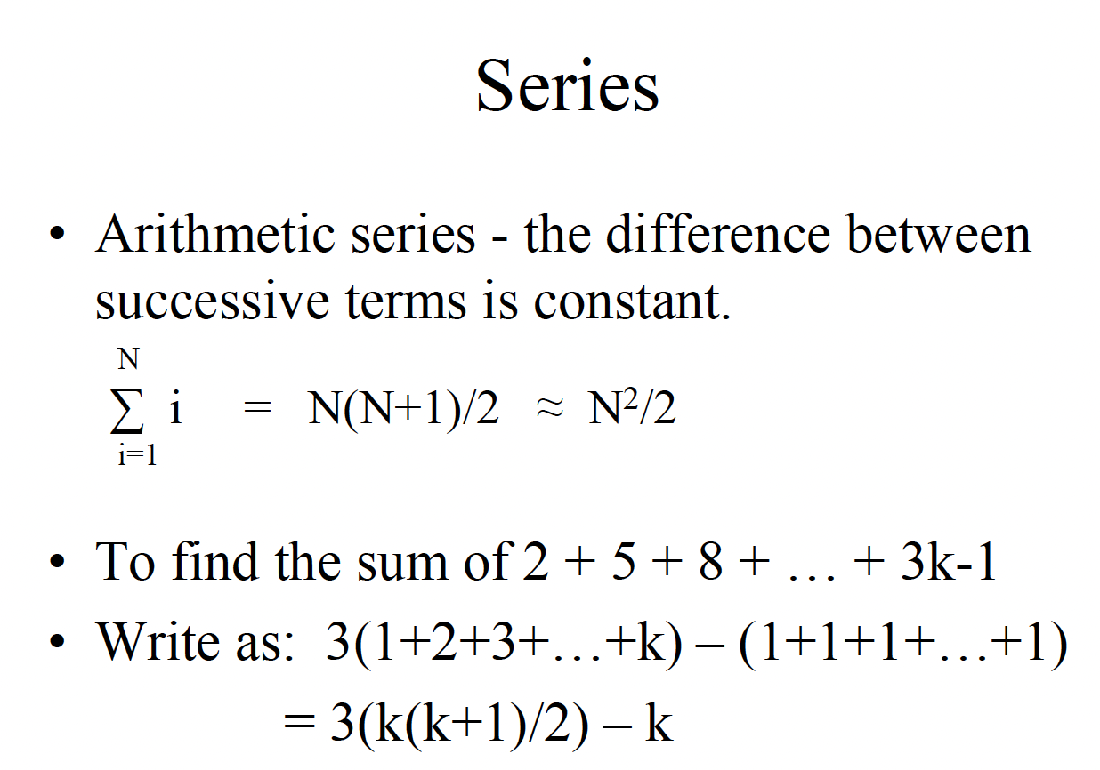

Slide 12
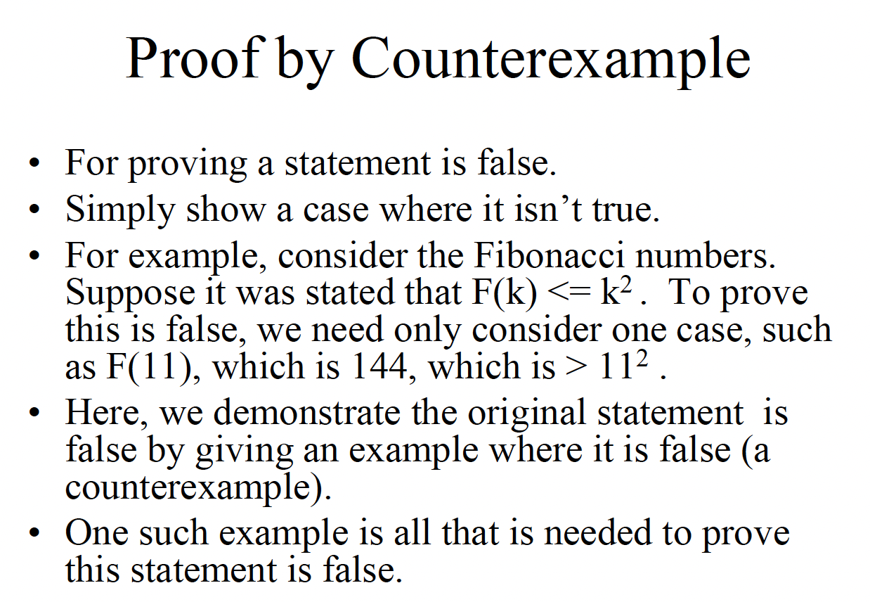

Slide 13
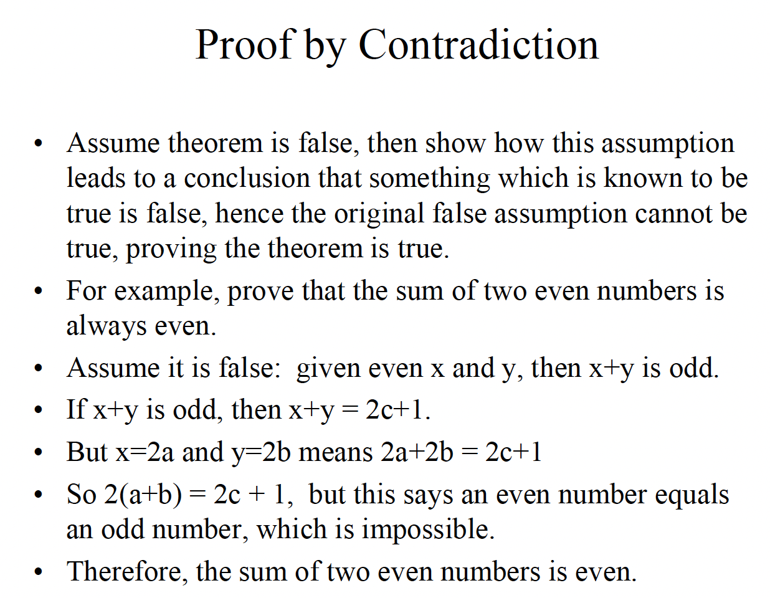

Slide 14
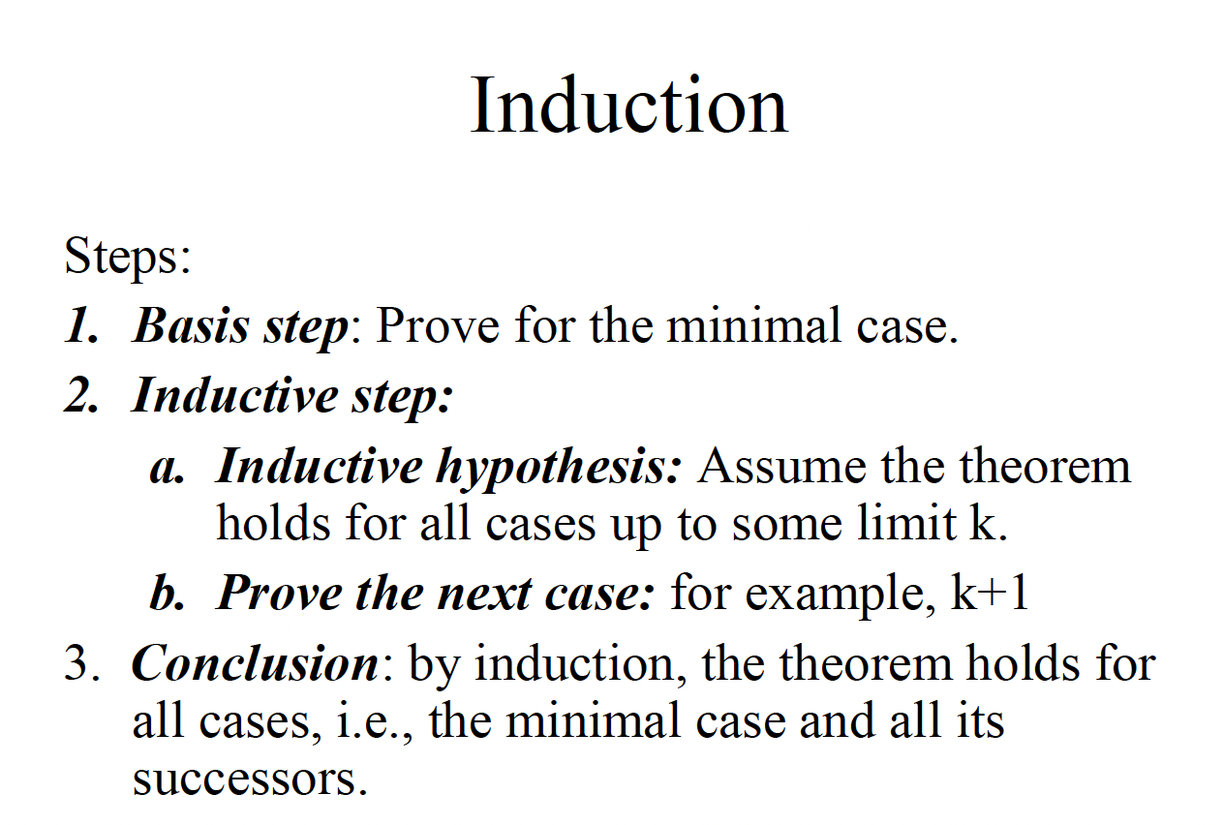

Slide 15
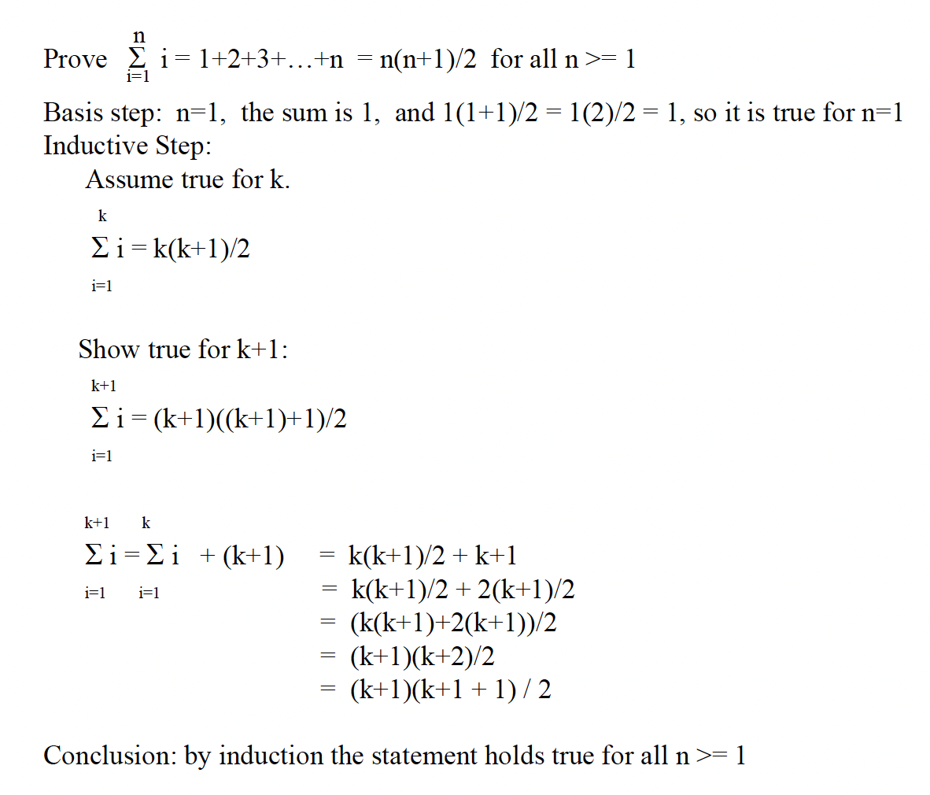

Slide 16
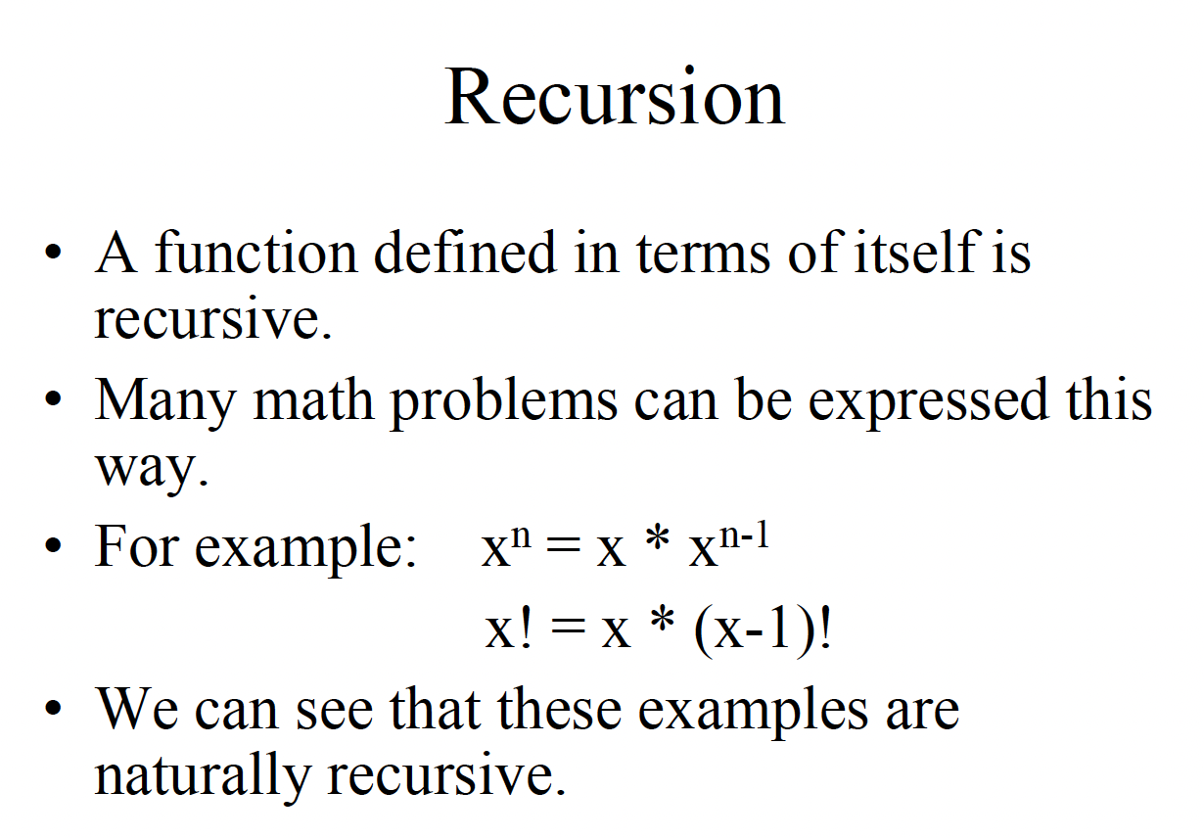

Slide 17
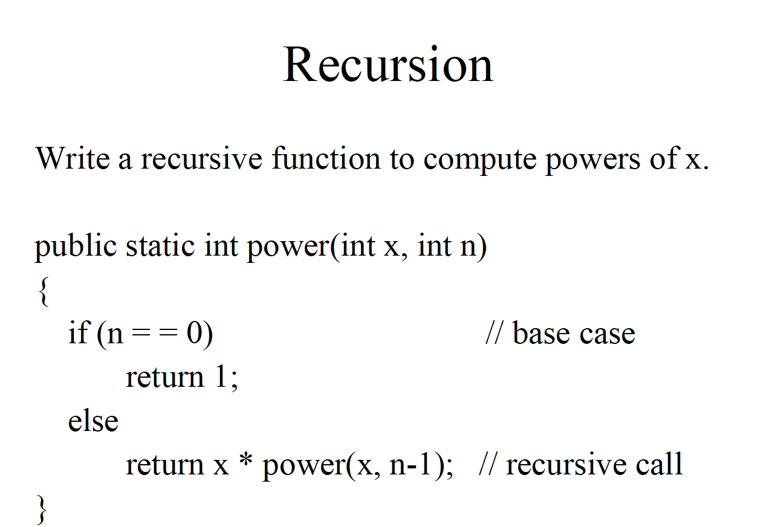

Slide 18
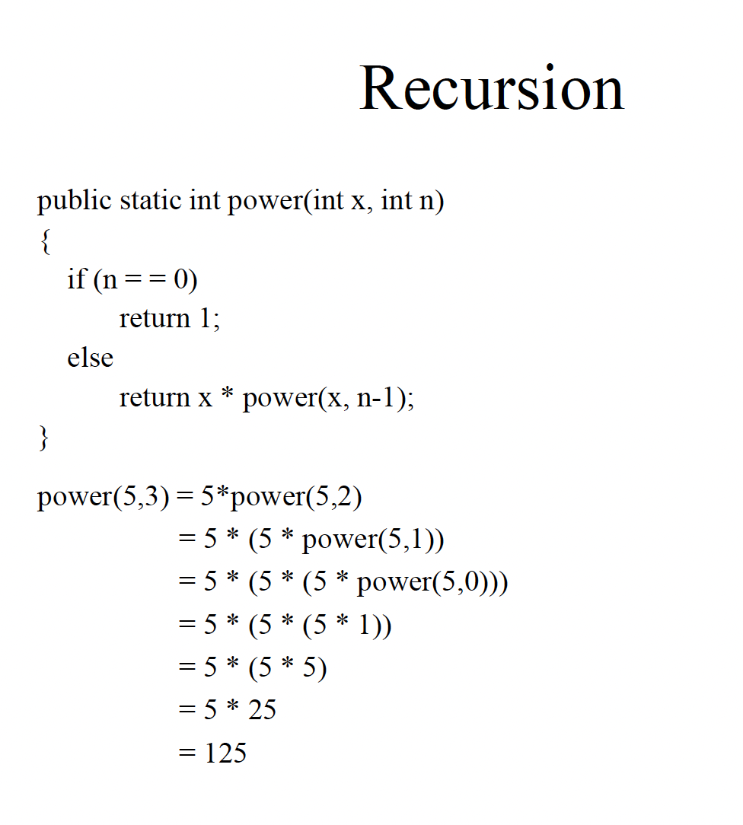

Slide 19
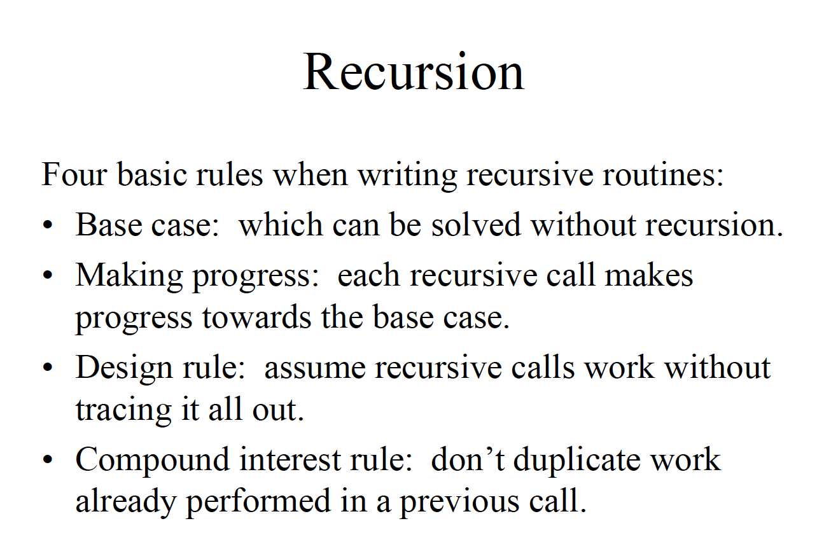

Slide 20
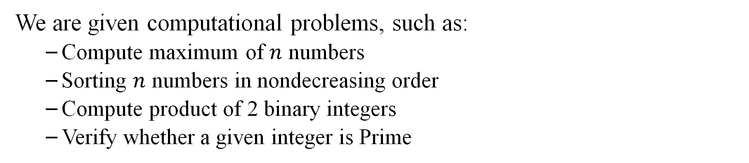
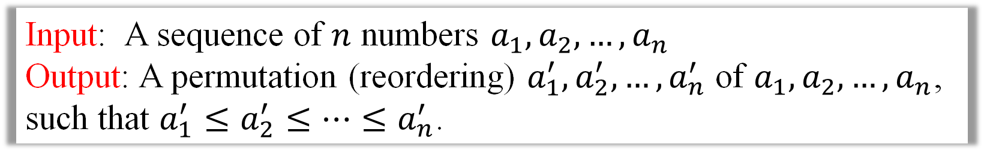
1.1 Introduction
We are given computational problems, such as:
Compute maximum of $n$ numbers
Sorting $n$ numbers in nondecreasing order
Compute product of 2 binary integers
Verify whether a given integer is Prime
Input: A sequence of $n$ numbers $a_{1}, a_{2}, …, a_{n}$
Output: A permutation (reordering) $a_{1}^{′}, a_{2}^{′}, …, a_{n}^{′}$ of $a_{1}, a_{2}, …, a_{n}$, such that $a_{1}^{′}≤a_{2}^{′}≤…{≤a}_{n}^{′}$.
Example
Sorting
Definition
Algorithm
An algorithm (alg.) is a well defined deterministic computational procedure that takes input and produces outputs.
Notes:
We design algorithm to solve problems.

Slide 21
1.2 Algorithm
Definition
Algorithm
An algorithm is a well defined deterministic computational procedure that takes input and produces outputs.
Definition Correctness
An alg. is correct if it halts and produces a correct output for every input instance.
Definition -
Efficiency
Execution of alg. requires resources: computing time and storage space.
Q: (1) How to measure computing time?
(2) When is an alg. better (faster) than another one?
(3) Is a given alg. optimal?
Notes:
There are 2 issues concerning algorithms: correctness and efficiency.

Slide 22
1.3.1 How to measure computing time of an alg.?
An alg. has to be implemented on a machine model such as Random Access Machine.
Computing time depends on size of input. The larger an input is, the more time is needed.
We associate with an input instance a size and measure computing time as a function of input size.

Slide 23
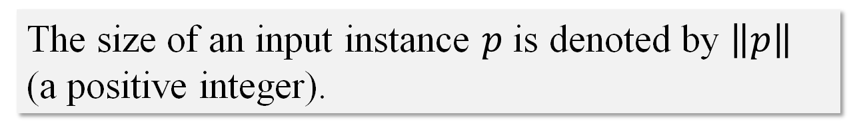
1.3.2 How to measure computing time of an alg.?
Definition -
Input Size
The size of an input instance $p$ is denoted by $\left\|p\right\|$ (a positive integer).
Example
Size of sorting is number of items to be sorted.
Size of maximum problem is number of elements in the input.
Size of integer multiplication is sum of lengths of two binary integers in input.

Slide 24
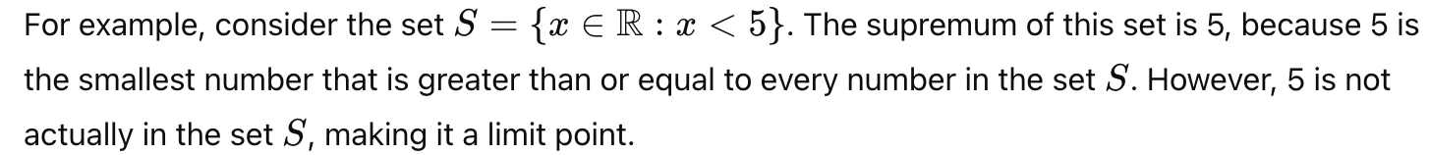
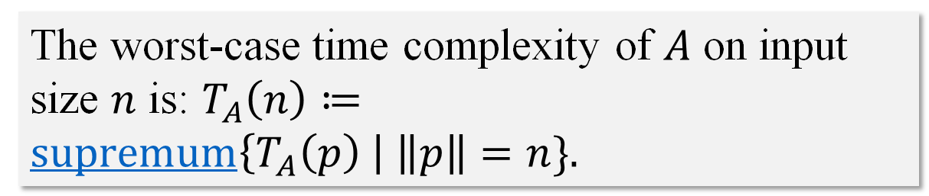
1.4.1 Worst-case Time Complexity
The running time of an algorithm on a particular input is the number of primitive operations or “steps” executed.
Let $A$ be an algorithm. Denote $T_{A}\left(p\right)$ = computing time of $A$ on input instance $p$.
The worst-case time complexity of $A$ on input size $n$ is: $T_{A}\left(n\right)≔\operatorname{supremum}\left\{T_{A}\left(p\right) \right| \left\|p\right\|=n\}.$
Worst-case Time Complexity
The supremum (or least upper bound) of a set is the smallest value that is greater than or equal to every element in that set. If a supremum exists, it is either a member of the set or a limit point of the set.
However, 5 is not actually in the set S, making it a limit point.
Notes:
The worst-case running time of an algorithm is an upper bound on the running time for any input. Knowing it gives us a guarantee that the algorithm will never take any longer.
This certainly is an issue in some cases, but in general the worst-case analysis of an algorithm has been found to do a reasonable job of capturing its efﬁciency in practice.

Slide 25

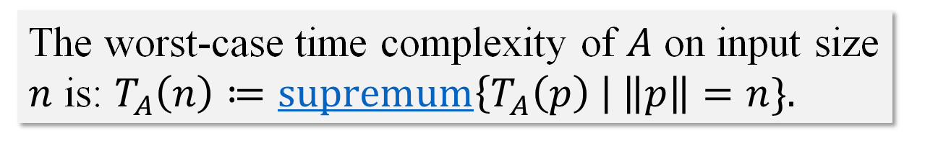
1.4.1 Worst-case Time Complexity
Worst-case Time Complexity
The worst-case time complexity of $A$ on input size $n$ is: $T_{A}\left(n\right)≔\operatorname{supremum}\left\{T_{A}\left(p\right) \right| \left\|p\right\|=n\}.$
Q: what if an algorithm performs well on most instances and just has a few pathological inputs on which it is very slow?
Goal: Determine $T_{A}\left(n\right)$ for some important algorithms.
Notes:
The worst-case running time of an algorithm is an upper bound on the running time for any input. Knowing it gives us a guarantee that the algorithm will never take any longer.
This certainly is an issue in some cases, but in general the worst-case analysis of an algorithm has been found to do a reasonable job of capturing its efﬁciency in practice.

Slide 26

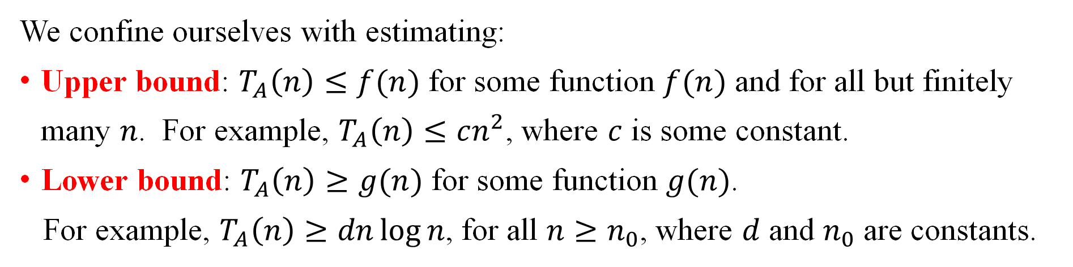
1.4.2 Worst-case Time Complexity
Let $A$ be an algorithm. Denote $T_{A}\left(p\right)$ = computing time of $A$ on input instance $p$.
Worst-case Time Complexity
The worst-case time complexity of $A$ on input size $n$ is: $T_{A}\left(n\right)≔\operatorname{supremum}\left\{T_{A}\left(p\right) \right| \left\|p\right\|=n\}.$
Goal: Determine $T_{A}\left(n\right)$ for some important algorithms.
Not realistic!
We confine ourselves with estimating:
Upper bound: $T_{A}\left(n\right)≤f(n)$ for some function $f(n)$ and for all but finitely many $n$. For example, $T_{A}\left(n\right)≤cn^{2}$, where $c$ is some constant.
Lower bound: $T_{A}\left(n\right)≥g(n)$ for some function $g(n)$.
For example, $T_{A}\left(n\right)≥dn\log{n}$, for all $n≥n_{0}$, where $d$ and $n_{0}$ are constants.

Slide 27
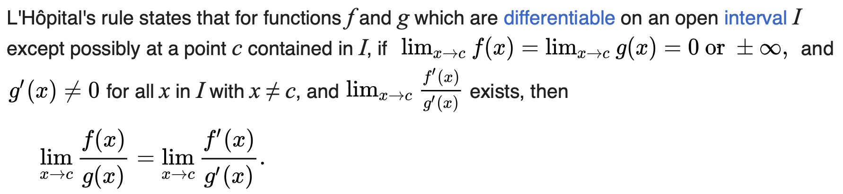
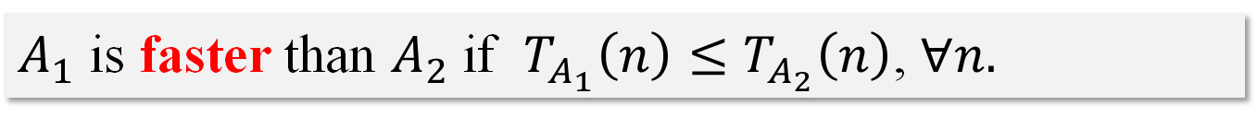
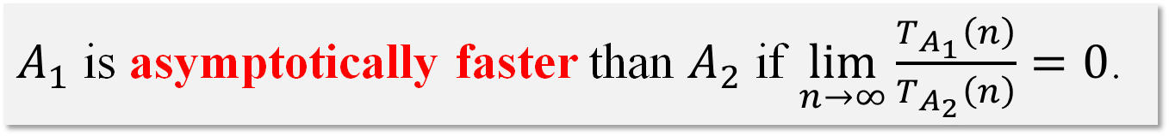
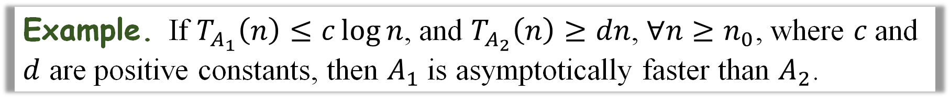
1.5 When is an alg. better (faster) than another one?
Let $A_{1}$ and $A_{2}$ be two algorithms that solve the same problem.
$A_{1}$ is faster than $A_{2}$ if $T_{A_{1}}\left(n\right)≤$ $T_{A_{2}}\left(n\right)$, $∀n.$
$A_{1}$ is asymptotically faster than $A_{2}$ if $\lim_{n→∞}{\frac{T_{A_{1}}\left(n\right)}{T_{A_{2}}\left(n\right)}=0}$.
L'Hôpital’s
Rule
Example. If $T_{A_{1}}\left(n\right)≤c\log{n}$, and $T_{A_{2}}\left(n\right)≥dn$, $∀n≥n_{0}$, where $c$and $d$ are positive constants, then $A_{1}$ is asymptotically faster than $A_{2}$.
Notes:
There maybe some algorithm performs well on most instances and just has a few pathological inputs on which it is very slow.
Average-case analysis—the obvious appealing alternative, in which one studies the performance of an algorithm averaged over “random” instances—can sometimes provide considerable insight, but very often it can also encounter some issues.

Slide 28
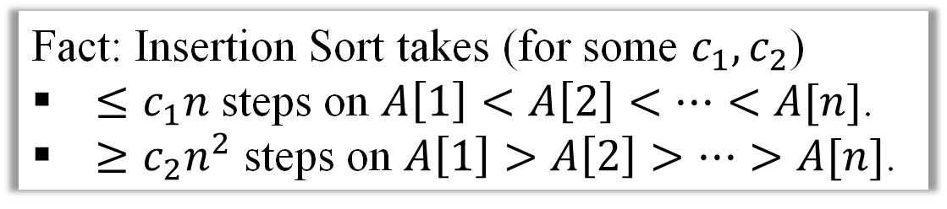
1.6.1 Average-case Time Complexity - Intuition
Example
The operation of INSERTION -SORT on the array A = 〈5, 2, 4, 6, 1, 3〉 .
Fact: Insertion Sort takes (for some $c_{1}, c_{2}$)
$≤c_{1}n$ steps on $A\left[1\right]<A\left[2\right]<…<A[n]$.
$≥c_{2}n^{2}$ steps on $A\left[1\right]>A\left[2\right]>…>A[n]$.

Slide 29
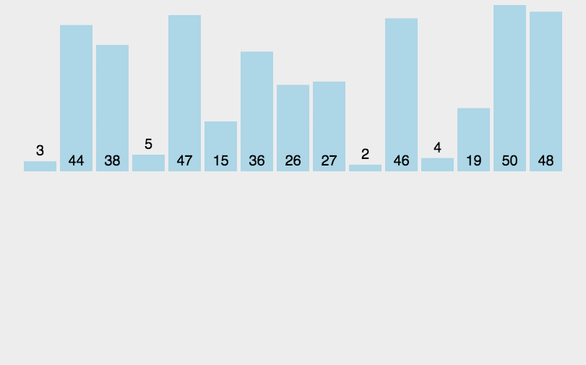
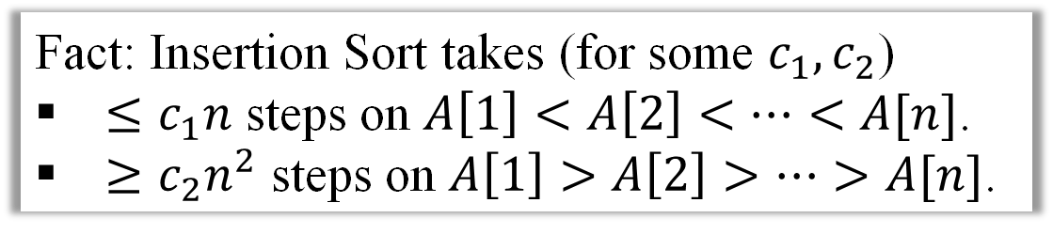
1.6.2 Average-case Time Complexity – Insertion Sort
Insertion Sort
Fact: Insertion Sort takes (for some $c_{1}, c_{2}$)
$≤c_{1}n$ steps on $A\left[1\right]<A\left[2\right]<…<A[n]$.
$≥c_{2}n^{2}$ steps on $A\left[1\right]>A\left[2\right]>…>A[n]$.
Running times of an alg. on different input instances of same size may vary significantly.

Slide 30

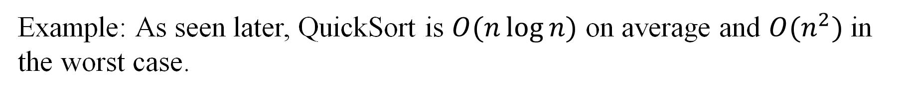
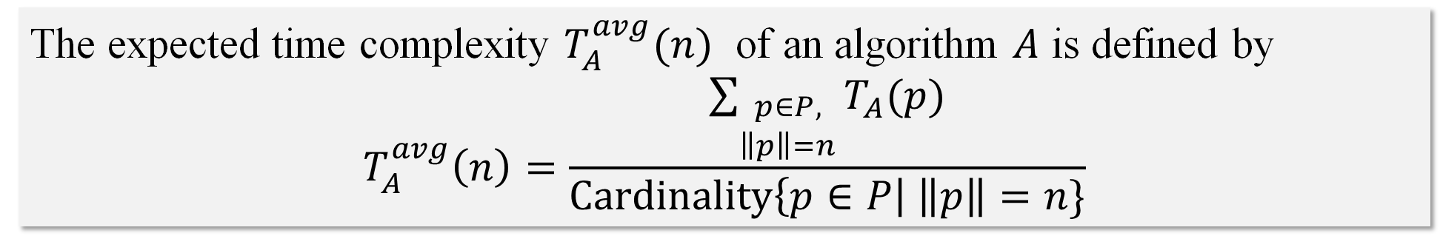
1.6.3 Average-case Time Complexity - Definition
Average-case Time Complexity
The expected time complexity $T_{A}^{avg}(n)$ of an algorithm $A$ is defined by
$$T_{A}^{avg}\left(n\right)=\frac{\sum_{\begin{aligned}p∈P, \\ \left\|p\right\|=n\end{aligned}}{T_{A}(p)}}{Cardinality\left\{p∈P\right| \left\|p\right\|=n\}}$$
Fact: $T_{A}^{avg}\left(n\right)≤T_{A}(n)$.
Example: As seen later, QuickSort is $O(n\log{n})$ on average and $O(n^{2})$ in the worst case.

Slide 32
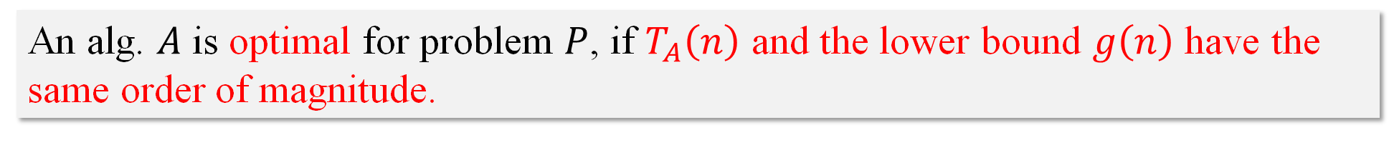
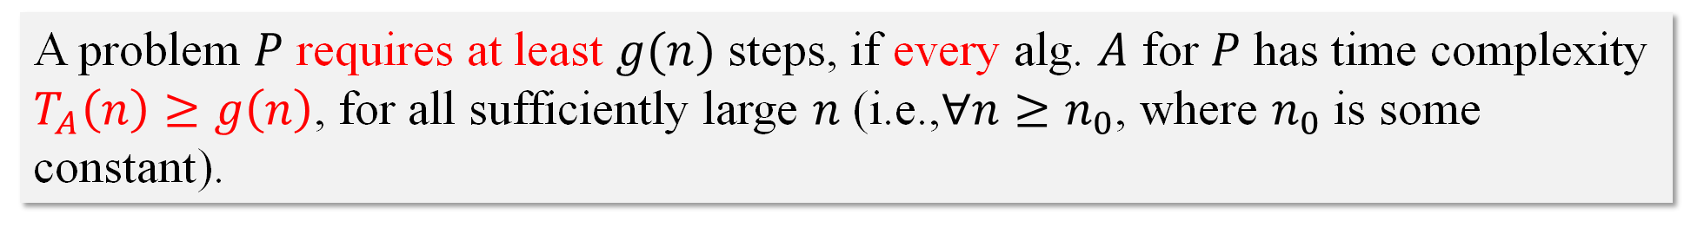
2.1 Complexity of problems
There are potentially infinitely many algorithms for a given problem.
Q: When is an algorithm $A$ for a problem $P$ optimal?
A problem can be solved within $f(n)$ steps, if $∃$ alg. $A$ such that $T_{A}\left(n\right)≤$ $f\left(n\right)$, $∀n.$
A problem $P$ requires at least $g(n)$ steps, if every alg. $A$ for $P$ has time complexity $T_{A}\left(n\right)≥g\left(n\right)$, for all sufficiently large $n$ (i.e.,$∀n≥n_{0}$, where $n_{0}$ is some constant).
An alg. $A$ is optimal for problem $P$, if $T_{A}\left(n\right)$ and the lower bound $g\left(n\right)$ have the same order of magnitude.
Notes:
"Order of magnitude" is a term used to describe the scale or size of a quantity in powers of ten. For example, when comparing two numbers, if one is about 10 times larger than the other, we say they differ by one order of magnitude. If one number is 100 times larger, they differ by two orders of magnitude, and so on.

Slide 33
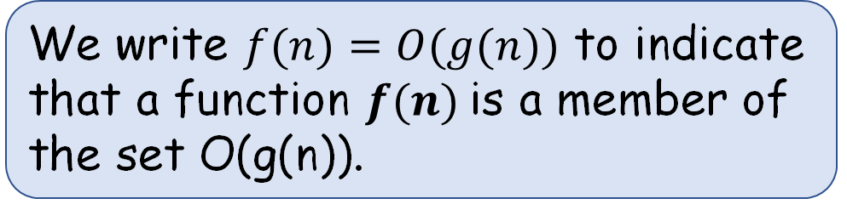
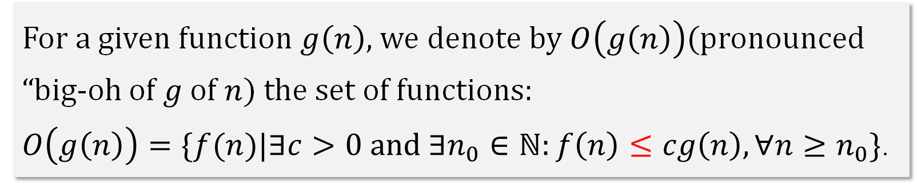
2.2.1 Order of Growth -- asymptotic upper bound ($O$-notation)
Denote $ℕ=\left\{0, 1, 2, …\right\}. Let g:ℕ→ℕ$ be a function.
For a given function $g\left(n\right)$, we denote by $O\left(g\left(n\right)\right)$(pronounced “big-oh of $g$ of $n$) the set of functions:
$O\left(g\left(n\right)\right)=\{f(n)|∃c>0 and ∃n_{0}∈ℕ:f\left(n\right)≤cg\left(n\right),∀n≥n_{0}\}$.
Upper bound
We write $f(n)=O(g(n))$ to indicate that a function $f(n)$is a member of the set O(g(n)).
Notes:
We use $O$-notation to give an upper bound on a function, to within a constant factor.

Slide 34
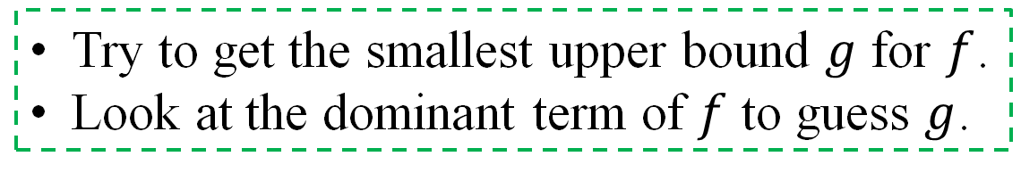
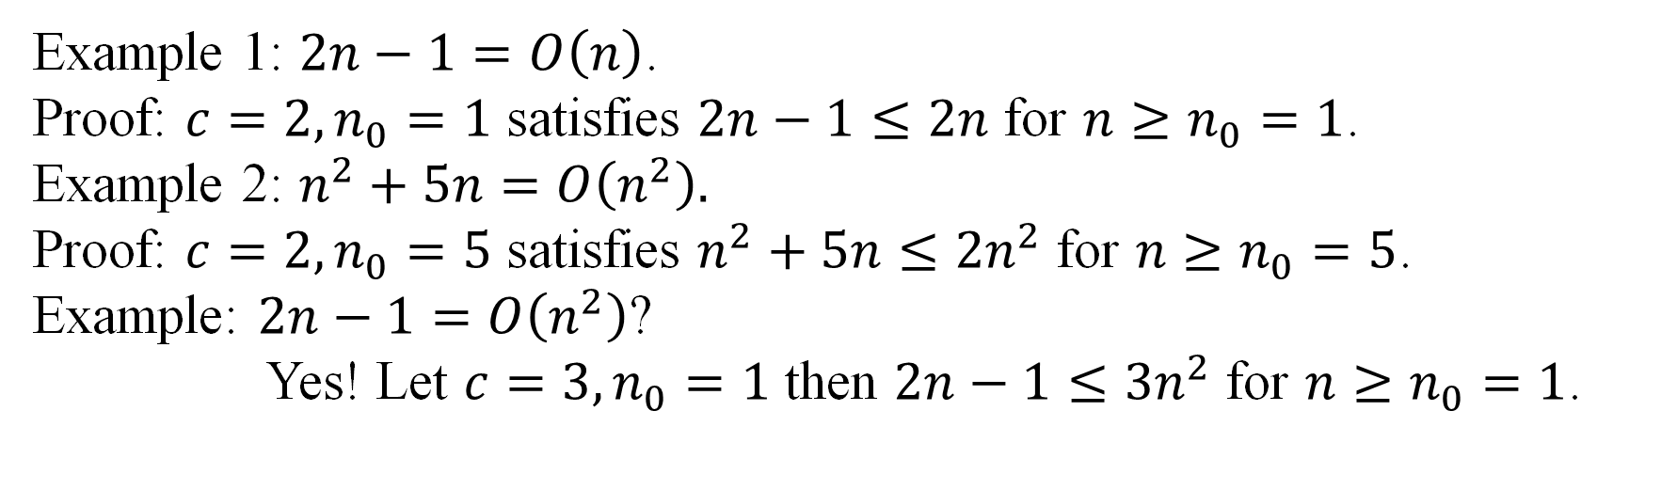
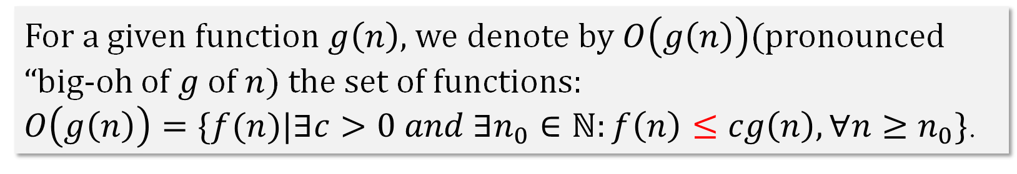
2.2.2 Asymptotic upper bound ($O$-notation) -- example
Denote $ℕ=\left\{0, 1, 2, …\right\}. Let g:ℕ→ℕ$ be a function.
For a given function $g\left(n\right)$, we denote by $O\left(g\left(n\right)\right)$(pronounced “big-oh of $g$ of $n$) the set of functions:
$O\left(g\left(n\right)\right)=\{f(n)|∃c>0 and ∃n_{0}∈ℕ:f\left(n\right)≤cg\left(n\right),∀n≥n_{0}\}$.
Upper bound
Example 1: $2n−1=O\left(n\right)$.
Proof: $c=2,n_{0}=1$ satisfies $2n−1≤2n$ for $n≥n_{0}=1$.
Example 2: $n^{2}+5n=O\left(n^{2}\right).$
Proof: $c=2,n_{0}=5$ satisfies $n^{2}+5n≤2n^{2}$ for $n≥n_{0}=5$.
Example: $2n−1=O\left(n^{2}\right)$?
Yes! Let $c=3,n_{0}=1$ then $2n−1≤3n^{2}$ for $n≥n_{0}=1$.
Try to get the smallest upper bound $g$ for $f$.
Look at the dominant term of $f$ to guess $g$.
Some rules

Slide 35
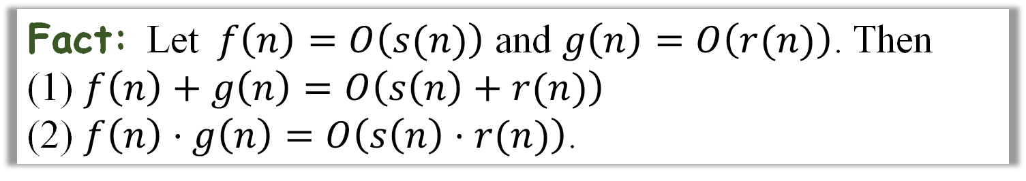
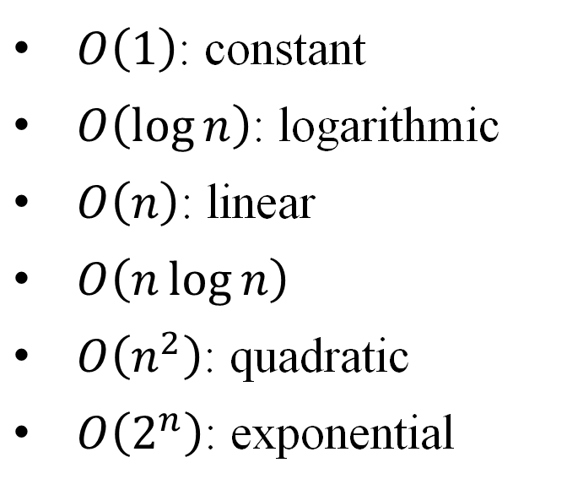
2.2.3 Asymptotic upper bound ($O$-notation) – common cases
$O\left(1\right)$: constant
$O\left(\log{n}\right)$: logarithmic
$O\left(n\right)$: linear
$O\left(n\log{n}\right)$
$O\left(n^{2}\right)$: quadratic
$O\left(2^{n}\right)$: exponential
Common cases
(n is the input size)
Fact: Let $f\left(n\right)=O\left(s(n)\right)$ and $g\left(n\right)=O\left(r(n)\right)$. Then
(1) $f\left(n\right)+$ $g\left(n\right)=O\left(s\left(n\right)+r(n)\right)$
(2) $f\left(n\right)⋅g\left(n\right)=O\left(s\left(n\right)⋅r(n)\right)$.

Slide 36
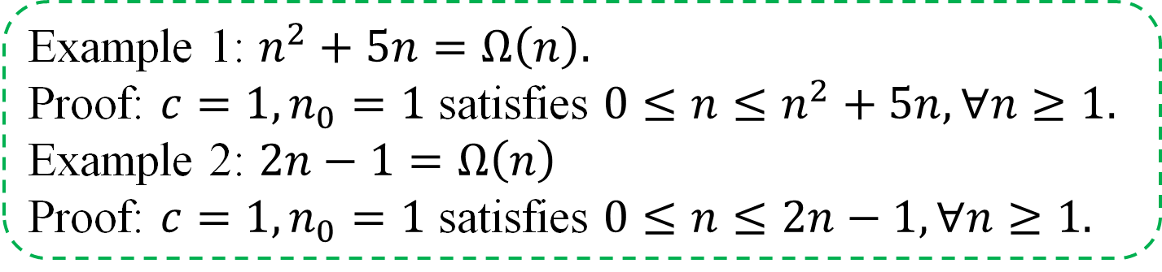
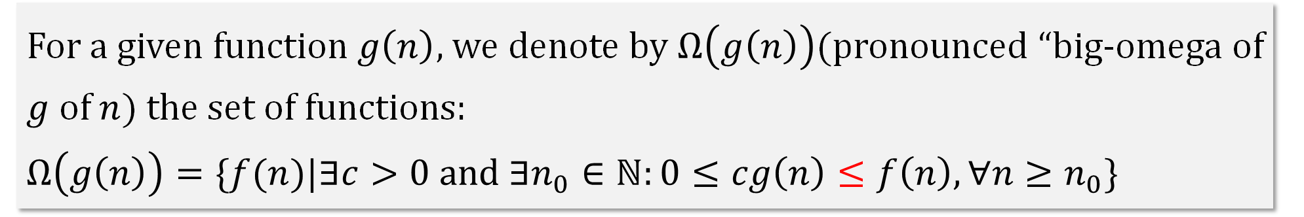
2.3 Order of Growth -- asymptotic lower bound ($Ω$-notation)
Denote $ℕ=\left\{0, 1, 2, …\right\}. Let g:ℕ→ℕ$ be a function.
For a given function $g\left(n\right)$, we denote by $Ω\left(g\left(n\right)\right)$(pronounced “big-omega of $g$ of $n$) the set of functions:
$$Ω\left(g\left(n\right)\right)=\{f(n)|∃c>0 and ∃n_{0}∈ℕ:0≤cg\left(n\right)≤f\left(n\right),∀n≥n_{0}\}$$
Lower bound
Example 1: $n^{2}+5n=Ω\left(n\right).$
Proof: $c=1,n_{0}=1$ satisfies $0≤n≤n^{2}+5n,∀n≥1.$
Example 2: $2n−1=Ω\left(n\right)$
Proof: $c=1,n_{0}=1$ satisfies $0≤n≤2n−1,∀n≥1.$
Notes:
We use $Ω$-notation to give a lower bound on a function, to within a constant factor.

Slide 37
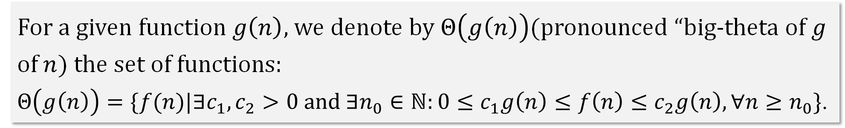
2.4.1 Order of Growth -- asymptotic tight bound ($Θ$-notation)
Denote $ℕ=\left\{0, 1, 2, …\right\}. Let g:ℕ→ℕ$ be a function.
For a given function $g\left(n\right)$, we denote by $Θ\left(g\left(n\right)\right)$(pronounced “big-theta of $g$ of $n$) the set of functions:
$$Θ\left(g\left(n\right)\right)=\{f(n)|∃c_{1},c_{2}>0 and ∃n_{0}∈ℕ:0≤c_{1}g\left(n\right)≤f\left(n\right)≤c_{2}g\left(n\right),∀n≥n_{0}\}\text{.}$$
Theorem
Notes:
if there exist positive constants c1 and c 2 such that it can be “sandwiched” between c 1 g(n) and c 2 g(n), for sufﬁciently large n.
g(n) is an asymptotically tight bound for f (n).
In practice, rather than using Theorem 3.1 to obtain asymptotic upper and lower bounds from asymptotically tight bounds, we usually use it to prove asymptotically tight bounds from asymptotic upper and lower bounds.

Slide 38
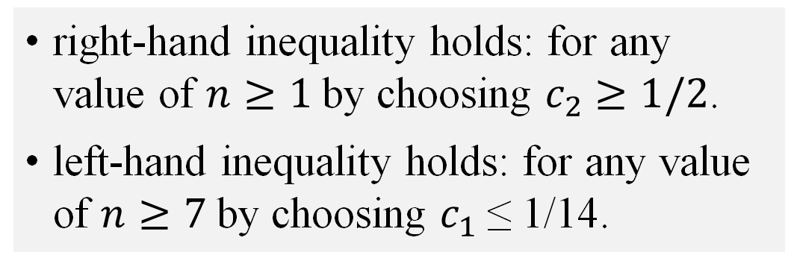

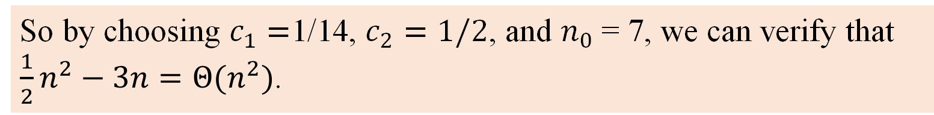
2.4.2 Asymptotic tight bound ($Θ$-notation) – example
$$Θ\left(g\left(n\right)\right)=\{f(n)|∃c_{1},c_{2}>0 and ∃n_{0}∈ℕ:0≤c_{1}g\left(n\right)≤f\left(n\right)≤c_{2}g\left(n\right),∀n≥n_{0}\}\text{.}$$
Prove:
We must determine positive constants $c_{1},c_{2}$and $n_{0}$ such that
right-hand inequality holds: for any value of $n≥1$by choosing $c_{2}$ $≥1/2$.
left-hand inequality holds: for any value of $n≥7$by choosing $c_{1}$≤ 1/14.
So by choosing $c_{1}=$1/14, $c_{2}=1/2$, and $n_{0}$= 7, we can verify that $\frac{1}{2}n^{2}−3n=Θ(n^{2})$.
Notes:
if there exist positive constants c1 and c 2 such that it can be “sandwiched” between c 1 g(n) and c 2 g(n), for sufﬁciently large n.
g(n) is an asymptotically tight bound for f (n).
The right-hand inequality can be made to hold for any value of n ≥ 1 by choosing c 2 ≥ 1/2. Likewise, the left-hand inequality can be made to hold for any value of n ≥ 7 by choosing c 1≤ 1/14.

Slide 39
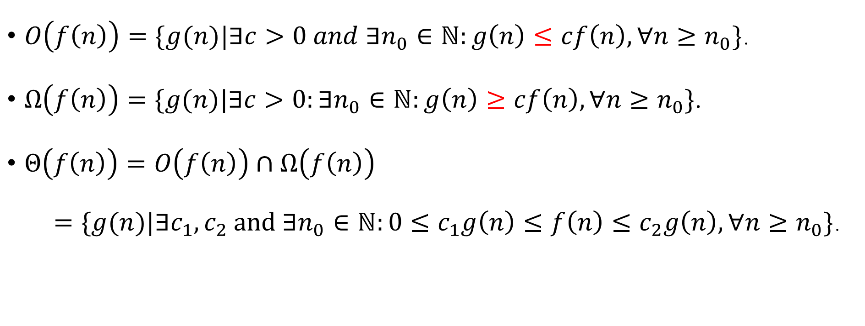
2.2.1 Order of Growth
Denote $ℕ=\left\{0, 1, 2, …\right\}. Let f:ℕ→ℕ$ be a function.
$O\left(f\left(n\right)\right)=\{g(n)|∃c>0 and ∃n_{0}∈ℕ:g\left(n\right)≤cf\left(n\right),∀n≥n_{0}\}$.
$Ω\left(f\left(n\right)\right)=\{g(n)|∃c>0:∃n_{0}∈ℕ:g\left(n\right)≥cf\left(n\right),∀n≥n_{0}\}\text{.}$
$Θ\left(f\left(n\right)\right)=O\left(f\left(n\right)\right)∩Ω\left(f\left(n\right)\right)$
$=\{g(n)|∃c_{1},c_{2} and ∃n_{0}∈ℕ:0≤c_{1}g\left(n\right)≤f\left(n\right)≤c_{2}g\left(n\right),∀n≥n_{0}\}$.

Slide 40
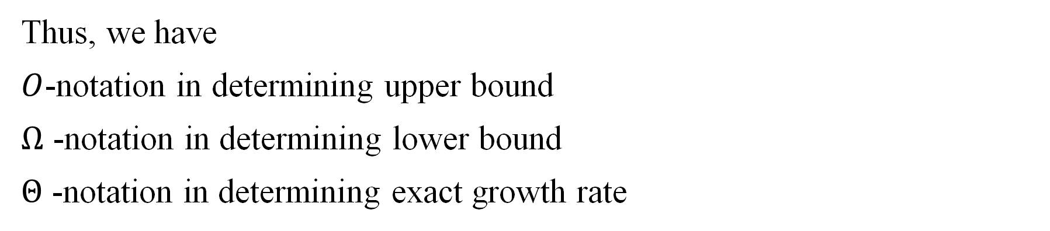

2.2.2 Order of Growth
Thus, we have
$O$-notation in determining upper bound
$Ω$ -notation in determining lower bound
$Θ$ -notation in determining exact growth rate
Remarks:
Instead of $n^{2}+5n∈n^{2}+O\left(n\right)⊆O(n^{2})$, we write $n^{2}+5n=n^{2}+O(n)=O(n^{2})$.
Expressions containing $O$-notation denote sets of functions. They are read from left to right only.
Thus, $S_{1}=S_{2}=…=S_{k}$ represents sequence of larger and larger sets of functions.

Slide 41



2.5.1 Further Asymptotic notations
Fact: Let $f\left(n\right)=O\left(s(n)\right)$ and $g\left(n\right)=O\left(r(n)\right)$. Then
(1) $f\left(n\right)+$ $g\left(n\right)=O\left(s\left(n\right)+r(n)\right)$
(2) $f\left(n\right)⋅g\left(n\right)=O\left(s\left(n\right)⋅r(n)\right)$.
A function $f\left(n\right)$ is monotonically increasing if $f\left(m\right)≤f\left(n\right), ∀m≤n$.
Proposition: Let $c>0, a>1$ be constant and $f\left(n\right)$ be a monotonically increasing function. Then ${f\left(n\right)}^{c}=O(a^{f(n)})$.
Example: (1) $f\left(n\right)=\log{n}$. Then ${(\log{n})}^{c}=O\left(a^{\log{n}}\right)=O(n^{\log{a}})$
(2) $f\left(n\right)=n$. Then $n^{c}=O(a^{n})$, $a>1$.

Slide 42





2.5 Further Asymptotic notations
Big-oh: $O\left(g\left(n\right)\right)=\{f(n)|∃c>0 and ∃n_{0}∈ℕ:f\left(n\right)≤cg\left(n\right),∀n≥n_{0}\}$.
The asymptotic upper bound provided by O-notation may or may not be asymptotically tight.
Example: The bound $2n^{2}=O\left(n^{2}\right)$ is asymptotically tight, but the bound $2n=O\left(n^{2}\right)$is not.
Small-oh: denote an upper bound that is not asymptotically tight $f\left(n\right)=o(g\left(n\right))$ if $for any c>0 and ∃n_{0}∈ℕ:f\left(n\right)<cg\left(n\right),∀n≥n_{0}$.
Alternative Def for $f\left(n\right)=o(g\left(n\right))$: $\lim_{n→∞}{\frac{f\left(n\right)}{g\left(n\right)}=0}$.
If $\lim_{n→∞}{\frac{f\left(n\right)}{g\left(n\right)}=}∞$, we write $f\left(n\right)=ω(g\left(n\right))$
Example: $2n=o\left(n^{2}\right)$ but $2n^{2}≠o\left(n^{2}\right)$.
Notes:
The deﬁnitions of O-notation and o-notation are similar. The main difference is that in f (n) = O(g(n)), the bound 0 ≤ f (n) ≤ cg(n) holds for some constant c > 0, but in f (n) = o(g(n)), the bound 0 ≤ f (n) < cg(n) holds for all constants c > 0.
in the o-notation, the function f (n) becomes insigniﬁcant relative to g(n) as n approaches inﬁnity; that is,

Slide 43


3.1 Merge Sort
Input: A sequence of $n$ numbers $a_{1}, a_{2}, …, a_{n}$
Output: A permutation (reordering)) $a_{1}^{′}, a_{2}^{′}, …, a_{n}^{′}$ of $a_{1}, a_{2}, …, a_{n}$, such that $a_{1}^{′}≤a_{2}^{′}≤…{≤a}_{n}^{′}$.
Sorting
Divide: Split array of size $n$ into subarrays of size $n/2$.
Conquer: Sort 2 subarrays recursively using Merge Sort.
Combine: Merge sorted subarrays to produce sorted array.
Merge Sort
The recursion “bottoms out” when the sequence to be sorted has length 1, in which case there is no work to be done, since every sequence of length 1 is already in sorted order.
Notes:
This is an example of divide-and-conquer.
Divide the problem into a number of subproblems.
Conquer the subproblems by solving them recursively. If the subproblem sizes are small enough, however, just solve the subproblems in a straightforward manner.
Combine the solutions to the subproblems into the solution for the original problem.

Slide 44


3.2.1 Merge Sort - algorithm
where MERGE($A, p, q, r$) is procedure to merge sorted $A[p…q]$ and $A\left[q+1,…,r\right].$
Notes:
The key operation of the merge sort algorithm is the merging of two sorted sequences in the “combine” step.

Slide 45

3.2.2 Merge Sort - example
4 7 8 2
Divide: Split array of size $n$ into subarrays of size $n/2$.
Conquer: Sort 2 subarrays recursively using Merge Sort.
Combine: Merge sorted subarrays to produce sorted array.
4 7
8 2
4
7
8
2
4 7
2 8
2 4 7 8

Slide 46

3.2.3 Merge Sort - complexity
Merging $n$ elements takes $Θ(n)$ steps.
Thus, the running time of MERGE-SORT is: $T\left(n\right)=2T\left(n/2\right)+Θ(n)$.
This recurrence has solution:
$T\left(n\right)=O(n\log{n})$.
A recurrence is an equation that describes a function in terms of its value on smaller inputs.
Q: How to solve recurrence?
Notes:
A recurrence is an equation that describes a function in terms of its value on smaller inputs.

Slide 47
4 Solving recurrences
Q: How to solve recurrence?
Substitution method
Recursion tree method
Master Theorem

Slide 48

4.1 Substitution method – example 1
Idea: guess a solution & verify.
Example: $T\left(n\right)=2T\left(\left\lfloor n/2\right\rfloor \right)+n$, $T\left(1\right)=1$.
Guess: $T\left(n\right)=O(n\log{n})$
Claim: $∃c>0 and ∃n_{0}∈ℕ: T\left(n\right)≤cn\log{n}, ∀n≥n_{0}$.
Proof: By induction on $n$.
Base: $n=2$. To make $T\left(2\right)=2T\left(1\right)+2=4≤c2\log{2}$ hold, set $c≥2.$
Induction hypothesis: Assume it holds for all $m, 2≤m<n$: $T\left(m\right)≤cm\log{m}$.
We show claim holds true for $n$.

Slide 49

4.2 Substitution method – example 2
Example: $T\left(n\right)=T\left(\left\lfloor \frac{n}{2}\right\rfloor \right)+T\left(\left\lceil \frac{n}{2}\right\rceil \right)+1$, $T\left(1\right)=1$.
Guess: $T\left(n\right)=O(n)$
Claim: $∃c>0 and ∃n_{0}∈ℕ: T\left(n\right)≤cn, ∀n≥n_{0}$.
Proof: By induction on $n$.
Base: $n=2$. To make $T\left(2\right)=T\left(1\right)+T(1)+1=3≤2c$ hold, set $c≥3/2.$
IH: Assume it holds true for all $m, where 2≤m<n$: $T\left(m\right)≤cm$.
We show claim holds true for $n$.
Noting $\left\lfloor \frac{n}{2}\right\rfloor ≤\left\lceil \frac{n}{2}\right\rceil <n$, we have $T\left(n\right)=T\left(\left\lfloor \frac{n}{2}\right\rfloor \right)+T\left(\left\lceil \frac{n}{2}\right\rceil \right)+1$
$≤c\left(\left\lfloor \frac{n}{2}\right\rfloor \right)+c\left(\left\lceil \frac{n}{2}\right\rceil \right)+1=cn+1≰cn$.
Notes:
Can try a larger guess, say T (n) = O(n 2 ), which can be made to work, but in fact, our guess that the solution is T(n) = O(n) is correct. In order to show this, however, we must make a stronger inductive hypothesis.
Intuitively, our guess is nearly right: we’re only off by the constant 1, a lower-order term. Nevertheless, mathematical induction doesn’t work unless we prove the exact form of the inductive hypothesis. We overcome our difﬁculty by subtracting a lower-order term from our previous guess.

Slide 50

4.2 Substitution method – example 2 (cont.)
Example: $T\left(n\right)=T\left(\left\lfloor \frac{n}{2}\right\rfloor \right)+T\left(\left\lceil \frac{n}{2}\right\rceil \right)+1$, $T\left(1\right)=1$.
New guess: $T\left(n\right)≤cn−b$ for some $b≥1$.
Claim: $∃c>0 and ∃n_{0}∈ℕ: T\left(n\right)≤cn−b, ∀n≥n_{0}$.
Proof: By induction on $n$.
Base: $n=2$. To make $T\left(2\right)=T\left(1\right)+T\left(1\right)+1=3≤2c−b$ hold.
IH: Assume it holds true for all $m:2≤m<n$.
We show claim holds true for $n$.
$$T\left(n\right)=T\left(\left\lfloor \frac{n}{2}\right\rfloor \right)+T\left(\left\lceil \frac{n}{2}\right\rceil \right)+1$$
$≤c\left(\left\lfloor \frac{n}{2}\right\rfloor \right)−b+c\left(\left\lceil \frac{n}{2}\right\rceil \right)−b+1$
$=cn−2b+1≤cn−b$, for $b≥1$.
Now simply choose $c$ and $b$ such that the basis works.
Notes:
As before, the constant c must be chosen large enough to handle the boundary conditions.

Slide 51

Notes:
As before, the constant c must be chosen large enough to handle the boundary conditions.

Slide 52

4.3 Substitution method – example 3 (changing variables)
Example: $T\left(n\right)=2T\left(\sqrt{n}\right)+\log{n}$
Renaming $m=log{n}$, then ${n=2}^{m}$.
Thus, we have $T\left(2^{m}\right)=2T\left(2^{m/2}\right)+m$.
Letting $S\left(m\right)=$ $T\left(2^{m}\right)$, we obtain $S\left(m\right)=2S\left(\frac{m}{2}\right)+m$.
Thus, $S\left(m\right)=O(m\log{m})$.
Therefore, $T\left(n\right)=T\left(2^{m}\right)$
$=S(m)$
$=O(m\log{m})$
$=O(\log{n}\log{\log{n}})$.
Remark: Algebraic manipulation helps!
Notes:
Sometimes, a little algebraic manipulation can make an unknown recurrence similar to one you have seen before.
which looks difﬁcult. We can simplify this recurrence, though, with a change of variables.

Slide 53


4.2 The iteration method
Example: $T\left(n\right)=3T\left(\left\lfloor \frac{n}{4}\right\rfloor \right)+n$
We have $T\left(n\right)=n+3\left(\left\lfloor \frac{n}{4}\right\rfloor +3T\left(\left\lfloor \frac{\left\lfloor \frac{n}{4}\right\rfloor }{4}\right\rfloor \right)\right)$
$=n+3\left\lfloor \frac{n}{4}\right\rfloor +3^{2}T\left(\left\lfloor \frac{n}{4^{2}}\right\rfloor \right)$
$=n+3\left\lfloor \frac{n}{4}\right\rfloor +3^{2}\left(\left\lfloor \frac{n}{4^{2}}\right\rfloor \right)+…+3^{\log_{4}n{−1}}T\left(\left\lfloor \frac{n}{4^{\log_{4}n{−1}}}\right\rfloor \right)$
$+3^{\log_{4}n}T\left(\left\lfloor \frac{n}{4^{\log_{4}n}}\right\rfloor \right)$ (last term is when $i=\log_{4}{n}$)
$≤n+\frac{3}{4}n+{\left(\frac{3}{4}\right)}^{2}n+…+{\left(\frac{3}{4}\right)}^{\log_{4}n{−1}}n+Θ(3^{\log_{4}n})$
$≤n\sum_{k=0}^{∞}{{\left(\frac{3}{4}\right)}^{k}}+Θ\left(3^{\log_{4}n}\right)=O\left(n\right)+o\left(n\right)=O(n)$
$$=O\left(1\right)$$
Notes:
This is an example of divide-and-conquer.

Slide 54
4.4.1 Recursion tree
Although the substitution method can provide a succinct proof that a solution to a recurrence is correct, it is sometimes difﬁcult to come up with a good guess.
In a recursion tree, each node represents the cost of a single subproblem somewhere in the set of recursive function invocations.
We sum the costs within each level of the tree to obtain a set of per-level costs.
Then we sum all the per-level costs to determine the total cost of all levels of the recursion.
A recursion tree is best used to generate a good guess, which is then veriﬁed by the substitution method.

Slide 55


4.4.2 Recursion tree
Example: $T\left(n\right)=2T\left(\frac{n}{2}\right)+n^{2}$
Height of tree $=\log{n}$
Thus, $T\left(n\right)≤n^{2}\left(1+2⋅{\left(\frac{1}{2}\right)}^{2}+4⋅{\left(\frac{1}{4}\right)}^{2}+…\right)$
$=n^{2}\left(1+\frac{1}{2}+\frac{1}{4}+…\right)$
$=Θ(n^{2})$

Slide 56
5.1 Master Theorem

Slide 57




5.2.1 Master Theorem - examples
Example 1: $T\left(n\right)=2T\left(\frac{n}{2}\right)+Θ(n)$
Thus, $a=2, b=2, \log_{b}{a}=1, f\left(n\right)=Θ\left(n\right)=Θ(n^{\log_{2}{2}}).$
Case 2 $⇒T\left(n\right)=O(n\log{n})$
Example 2: $T\left(n\right)=3T\left(\frac{n}{2}\right)+Θ(n)$
Thus, $a=3, b=2, \log_{b}{a}=\log_{2}{3>1}, f\left(n\right)=Θ\left(n\right)=O(n^{\log_{2}{3}−ε})$.
Case 1 $⇒T\left(n\right)=Θ(n^{\log_{2}{3}})$
Example 3: $T\left(n\right)=9T\left(\frac{n}{3}\right)+Θ(n)$
Thus, $a=9, b=3, \log_{b}{a}=\log_{3}{9=2},f\left(n\right)=Θ\left(n\right)=O(n^{2−ε})$.
Case 1 $⇒T\left(n\right)=Θ(n^{2})$

Slide 58


5.2.2 Master Theorem - examples
Example 4: $T\left(n\right)=T\left(\frac{2n}{3}\right)+Θ(1)$
Thus, $a=1, b=\frac{3}{2}, \log_{b}{a}=0$. $⇒$ $n^{\log_{b}{a}}=1$
$f\left(n\right)=Θ\left(1\right)=Θ(n^{\log_{b}{a}})$. Case 2 $⇒T\left(n\right)=O(\log{n})$
Example 5: $T\left(n\right)=3T\left(\frac{n}{4}\right)+n\log{n}$
Thus, $a=3, b=4, \log_{b}{a}=\log_{4}{3<1}$. $⇒$ $n^{\log_{b}{a}}=n^{\log_{4}{3}}$
Since $f\left(n\right)=Θ\left(n\log{n}\right)=Ω(n^{\log_{4}{3}+ε})$,
$af\left(\frac{n}{b}\right)=3\left(\frac{n}{4}\right)$ $\log\left(\frac{n}{4}\right)≤\left(\frac{3}{4}\right)n\log{n=c⋅f(n)}$, where $c=\frac{3}{4}<1$,
Case 3 $⇒T\left(n\right)=Θ\left(n\log{n}\right)$

Slide 59


5.3 More examples
For a recurrence of form $T\left(n\right)=aT\left(\frac{n}{b}\right)+f(n)$, we have the following examples:
(1) $T\left(n\right)=2T\left(\frac{n}{2}\right)+O\left(1\right)$ $⇒T\left(n\right)=O(n)$
$a=2, b=2, \log_{b}{a}=1$. $⇒$ $n^{\log_{b}{a}}=n$
$f\left(n\right)=O\left(1\right)=O(n^{\log_{b}{a}−ε })$. $→$ case 1
(2) $T\left(n\right)=2T\left(\frac{n}{2}\right)+n^{2}$ $⇒T\left(n\right)=O(n^{2})$
$a=2, b=2, \log_{b}{a}=1$ $⇒$ $n^{\log_{b}{a}}=n$
$f\left(n\right)=n^{2}=Ω(n^{\log_{b}{a}+ε })$. Since $af\left(\frac{n}{b}\right)=2f\left(\frac{n}{2}\right)=2×{(\frac{n}{2})}^{2}=\frac{1}{2}n^{2}→$ case 3
(3) $T\left(n\right)=2T\left(\frac{n}{2}\right)+Θ\left(n\right) ⇒T\left(n\right)=O(n\log{n})$
$a=2, b=2, \log_{b}{a}=1$ $⇒$ $n^{\log_{b}{a}}=n$
$f\left(n\right)=Θ\left(n\right)=Θ(n^{\log_{b}{a} })$. $→$ case 2

Slide 60
5.4.1 Master Theorem – proof idea

Slide 61




5.4.2 Master Theorem – proof idea
If $f\left(n\right)=O\left(s(n)\right)$ and $g\left(n\right)=O\left(r(n)\right)$. Then $f\left(n\right)+$ $g\left(n\right)=O\left(s\left(n\right)+r(n)\right)$.
(1) If $f(n)=O(n^{\log_{b}{a}−ε})$, then $f\left(\frac{n}{b^{j}}\right)=O({(\frac{n}{b^{j}})}^{\log_{b}{a}−ε})$. So
$$=\sum_{j=0}^{\log_{b}{n}−1}{a^{j}\frac{n^{\log_{b}{a}−ε}}{b^{j⋅(\log_{b}{a}−ε)}}}=n^{\log_{b}{a}−ε}\sum_{j=0}^{\log_{b}{n}−1}{\frac{a^{j}}{{{(b}^{\log_{b}{a}})}^{j}⋅b^{−εj}}}$$
Then $T\left(n\right)=Θ\left(n^{\log_{b}{a}}\right)+O\left(n^{\log_{b}{a}}\right)$
$=Θ\left(n^{\log_{b}{a}}\right)$, case 1 is proved.
$$=O(n^{\log_{b}{a}})$$

Slide 62


5.4.2 Master Theorem – proof idea
If $f\left(n\right)=O\left(s(n)\right)$ and $g\left(n\right)=O\left(r(n)\right)$. Then $f\left(n\right)+$ $g\left(n\right)=O\left(s\left(n\right)+r(n)\right)$.
(2) If $f(n)=Θ(n^{\log_{b}{a}})$, then $f\left(\frac{n}{b^{j}}\right)=Θ({(\frac{n}{b^{j}})}^{\log_{b}{a}})$. So
$$=\sum_{j=0}^{\log_{b}{n}−1}{a^{j}\frac{n^{\log_{b}{a}}}{b^{j⋅\log_{b}{a}}}}=n^{\log_{b}{a}}\sum_{j=0}^{\log_{b}{n}−1}{\frac{a^{j}}{{{(b}^{\log_{b}{a}})}^{j}}}$$
Then $T\left(n\right)=Θ\left(n^{\log_{b}{a}}\right)+Θ\left(n^{\log_{b}{a}}\log_{2}{n}\right)$
$=Θ\left(n^{\log_{b}{a}}\log_{2}{n}\right)$, case 2 is proved.
Then $g\left(n\right)=Θ\left(n^{\log_{b}{a}}\log_{b}{n}\right)=Θ\left(n^{\log_{b}{a}}\log_{2}{n}\right).$

Slide 63



5.4.2 Master Theorem – proof idea
If $f\left(n\right)=O\left(s(n)\right)$ and $g\left(n\right)=O\left(r(n)\right)$. Then $f\left(n\right)+$ $g\left(n\right)=O\left(s\left(n\right)+r(n)\right)$.
(3) If $af\left(\frac{n}{b}\right)≤cf(n)$, where $a≥1$, then $f\left(\frac{n}{b}\right)≤\frac{c}{a}f(n)$.
Replace $n$ in the above inequality by $\frac{n}{b}$, then $f\left(\frac{\frac{n}{b}}{b}\right)≤\frac{c}{a}f\left(\frac{n}{b}\right)≤\frac{c}{a}⋅\left(\frac{c}{a}f\left(n\right)\right)={(\frac{c}{a})}^{2}f\left(n\right)\text{.}$
Similarly, we can get $f\left(\frac{n}{b^{j}}\right)≤{(\frac{c}{a})}^{j}f\left(n\right)\text{.}$ So $a^{j}f\left(\frac{n}{b^{j}}\right)≤c^{j}f\left(n\right)$.
Since all terms in $g\left(n\right)$ are non-negative, then $g\left(n\right)≥a^{0}f\left(\frac{n}{b^{0}}\right)=f(n)$. So $g\left(n\right)=Ω(f(n))$.
Then $T\left(n\right)=Θ\left(n^{\log_{b}{a}}\right)+Θ\left(f(n)\right)=Θ\left(f(n)\right)$ since $f\left(n\right)=Ω(n^{\log_{b}{a+ε}})$, case 3 is proved.
.

Slide 64

5.5.1 Master Theorem – case cannot apply
Example: $T\left(n\right)=2T\left(\frac{n}{2}\right)+n\log{n}$
Thus, $a=2, b=2, \log_{b}{a}=1$. $⇒$ $n^{\log_{b}{a}}=n$
$f\left(n\right)=n\log{n}≠O(n^{1−ε})$
$≠Θ(n)$
$≠Ω(n^{1+ε})$
Master Theorem doesn’t apply!
Notes:
It might seem that case 3 should apply, since f (n) = n lg n is asymptotically larger than n log b a = n. The problem is that it is not polynomially larger. The ratio f (n)/n log b a = (n lg n)/n = lg n is asymptotically less than n for any positive constant . Consequently, the recurrence falls into the gap between case 2 and case 3.

Slide 65



5.5.2 Master Theorem –case cannot apply (cont.)
Example: $T\left(n\right)=2T\left(\frac{n}{2}\right)+n\log{n}$
Claim: $T\left(n\right)=Θ(n{\left(\log{n}\right)}^{2})$
From the proof idea for master theorem, we know that
$$T\left(n\right)=Θ\left(n^{\log_{b}{a}}\right)+\sum_{j=0}^{\log_{b}{n}−1}{a^{j}}\frac{n}{b^{j}}\log{\frac{n}{b^{j}}}$$
$=Θ\left(n\right)+\sum_{j=0}^{\log{n}−1}{n}(\log{n}−j)$
$=Θ(n{\left(\log{n}\right)}^{2})$
($a=b=2$)
Notes:
It might seem that case 3 should apply, since f (n) = n lg n is asymptotically larger than n log b a = n. The problem is that it is not polynomially larger. The ratio f (n)/n log b a = (n lg n)/n = lg n is asymptotically less than n for any positive constant . Consequently, the recurrence falls into the gap between case 2 and case 3.

Slide 66



5.5 Master Theorem–more examples
Example 1: $T\left(n\right)=5T\left(\frac{n}{2}\right)+{cn}^{2}$
Thus, $a=5, b=2, \log_{b}{a}=\log_{2}{5}, f\left(n\right)={cn}^{2}=O(n^{\log_{2}{5−ε}}).$
Case 1 $⇒T\left(n\right)=Θ(n^{\log_{2}{5}})$.
Example 2: $T\left(n\right)=4T\left(\frac{n}{2}\right)+\frac{n^{2}}{\log{n}}$
Thus, $a=4, b=2, \log_{b}{a}=\log_{2}{4=2}, f\left(n\right)=\frac{n^{2}}{\log{n}}=Θ(n^{2}\log^{−1}n)$.
We cannot use Master Theorem!
Master Theorem cannot be applied to $≥2$uneven recurrence:
$T\left(n\right)=T\left(\frac{n}{3}\right)+T\left(\frac{2n}{3}\right)+cn$
$T\left(n\right)=T\left(\frac{n}{4}\right)+T\left(\frac{n}{4}\right)+T\left(\frac{n}{2}\right)+cn$
Notes:
It might seem that case 3 should apply, since f (n) = n lg n is asymptotically larger than n log b a = n. The problem is that it is not polynomially larger. The ratio f (n)/n log b a = (n lg n)/n = lg n is asymptotically less than n for any positive constant . Consequently, the recurrence falls into the gap between case 2 and case 3.

Slide 67

Recursion Tree
T(n) = r T(n/c) + f (n)
T(n) is the total time complexity for a problem of size n.
r is the number of subproblems at each level of recursion.
n/c is the size of each subproblem, where c is a constant that divides the problem size.
f(n) is the time complexity of dividing the problem and combining the results of subproblems.
CS4349 Advanced Algorithm Design and Analysis

Slide 68

CS4349 Advanced Algorithm Design and Analysis

Slide 69

CS4349 Advanced Algorithm Design and Analysis

Slide 70

CS4349 Advanced Algorithm Design and Analysis

Slide 71
6 Summary
Notation of algorithms
Complexity of algorithms
Worst-case & average-case complexity of problems
Order of growth
Asymptotic notations
Recurrence relations
Substitution method
Iteration / Recursion tree method
Master Theorem
Insertion Sort
Merge Sort

